Slide 1

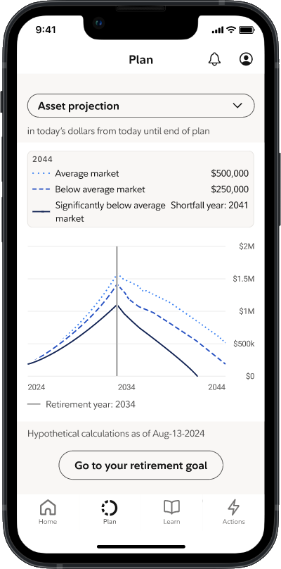
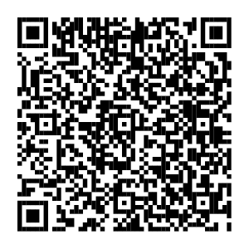
Make progress
on money goals— all year long.
Financial Wellness
Your financial wellness dashboard on NetBenefits® offers money tips, planning tools, and insights to help you understand your spending, create a plan, and track progress toward your goals—all with personalized insights to fit your life.
To view your dashboard, scan the code or visit
NetBenefits.com/dashboard.
Screenshot is for illustrative purposes only.
NetBenefits and the Fidelity Investments logo are registered service marks of FMR LLC.
Fidelity Brokerage Services LLC, Member NYSE, SIPC, 900 Salem Street, Smithfield, RI 02917
© 2025 FMR LLC. All rights reserved.
1191763.3.1

